Slide 1
HOSPITAL MANAGEMENT SYSTEM
Done by
SIVA SHANMUGAM.N
(REGISTER NUMBER: 21MIT439)
Under the Guidance of
Dr.T.CHRISTOPHER M.Sc., M.C.A., M.Ed., M.Phil., Ph.D.
Date:03/05/2023

Slide 2
SYNOPSIS
Introduction
Existing System
Proposed System
System Specification
Table Design
Module Description
Screenshots
Dataflow Diagram
Conclusion
Future Enhancement
Bibliography

Slide 3
INTRODUCTION
OVERVIEW OF THE PROJECT
Hospital Management System In PHP is web based application. The project Hospital Management system includes registration of patients, storing their details into the system. The web application has the facility to give a unique id for every patient and stores the details of every patient. It includes a search facility to know the current status of each patient . Patient can select availability of a doctor and using the id of specilization.
The Hospital Management System can be entered using a username and password. It is accessible either by an administrator .Only they can add data into the database. The data can be retrieved easily. The interface is very user-friendly. The data are well protected for personal use and make the data processing very fast.

Slide 4
EXISTING SYSTEM
Hospitals currently use a manual system for the management and maintainance of critical information. The current system requires numerous paper forms, with data stores spread through out the hospital management infrastructure. Often information is incomplete or does not follow management standards. Forms are often lost in transit between departments requiring a comprehensive auditing process to ensure that no vital information is lost. Multiple copies of the same information exist in the hospital and may lead to inconsistencies in data in various data stores.

Slide 5
DISADVANTAGES OF EXISTING SYSTEM
Manual process for earlier system.
Time Consuming for all process
Less Efficient
Less Accurate Not User Friendly
Right information is not retrieved at right time.
Need for more resources
There is chance to lose record details.

Slide 6
PROPOSED SYSTEM
The Hospital Management System is designed for any hospital to replace their existing manual paper based system. The new system is to control the information of patients. Its reduced time consume, Informations are retrieved at right time, not neet more manual resources and There is no chance to lose record details. These services are to be provided in an efficient, cost effective manner, with the goal of reducing the time and resources currently required for such tasks .

Slide 7
ADVANTAGES OF PROPOSED SYSTEM
APPOINTMENT MANAGEMENT: For hospitals having their own site, appointment widgets will be integrated onto the site. Patients visiting the hospital’s website can book online appointments with ease.
DATA SECURITY: Hospital Management System ensures high data security with data encryption. Besides, the authorized access ensures privacy. On the other hand, with secure logins, data storage proves safer.
COST EFFECTIVE: HMS not only saves time in the hospital but also is cost-effective in decreasing the number of people working on the system of manual entry of data and paperwork. The implementation of his will decrease the human intervention into the system thereby avoiding human-caused errors.
PATIENT MANAGEMENT: This module includes features such as patient registration, appointment scheduling, patient check-in, and medical record management.

Slide 8
SYSTEM SPECIFICATION
HARDWARE SPECIFICATION
Processor : AMD PRO 2.50 GHz
System RAM : 4 GB
Hard disk Drive : 400 GB and above
Keyboard : 82 buttons
Monitor : 14” colour monitor
SOFTWARE SPECIFICATION
Technology Implemented : Apache Server
Language Used : PHP 5.62(Developed in Core PHP)
Database : MY SQL
User Interface Design : HTML,CSS,BOOTSRAP,JAVASCRIPT
Web Browser : Mozilla,GoogleChrome,IE8,OPERA
Software : XAMPP

Slide 9
TABLE DESIGN
Table Name: admin
Table Description : This Table is represent Admin module. If you give Correct username and password it will login Successfully. Otherwise the system says invalid username or Password.
# | Field Name | Data Type
1 | Id | int(primarykey)
2 | Username | varchar(20)(Foreign Key)
3 | Password | varchar(20)
4 | Updationdate | varchar(20)

Slide 10
Table Name: doctors
Table Description : This table consist of all doctor personal details. Admin can add doctors and ID for separate.
# | Field Name | Data Type
1 | Doctorid | int(primarykey)
2 | Specialization | varchar(25)
3 | DoctorName | varchar(15)
4 | Address | Longtext
5 | DocFees | varchar(15)
6 | Contactno | bigint(11)
7 | DocEmail | varchar(20) (Foreign Key)
8 | Password | varchar(10)
9 | CreationDate | Timestamp
10 | UpdationDate | Timestamp

Slide 11
Table Name: doctorspecilization
Table Description : This Table represent Doctor Specilization. The admin will add doctor specilization.
# | Field Name | Data Type
1 | Id | int(primarykey)
2 | Specialization | varchar(20)(Foreign key)
3 | creationDate | Timestamp
4 | updationDate | Timestamp
Table Name: doctorslog
Table Description : This table is used to represent Doctor Log Session details. The admin can see the login and logout times of the doctor.
# | Field Name | Data Type
1 | Id | int(primarykey)
2 | Doctorid | varchar(25)(Foreign key)
3 | Doctorname | varchar(15)
4 | LoginTime | Timestamp
5 | Logout | varchar(20)
6 | Status | int(11)

Slide 12
Table Name: appointment
Table Description : This table is used for enter the Patient appointment details. Only the doctor has the authority to cancel a patient's appointment.
# | Field Name | Data Type
1 | Id | int(primarykey)
2 | doctorSpecialization | varchar(25)
3 | Doctorid | int(11) (Foreign key)
4 | Patientid | int(11) (Foreign key)
5 | cosultancyFees | int(11)
6 | appointmentDate | varchar(20)
7 | appointmentTime | varchar(20)
8 | PostingDate | Timestamp
9 | PatientStatus | int(10)
10 | doctorStatus | int(10)
11 | updationDate | Timestamp

Slide 13
Table Name: tblpatient
Table Description : This table is used to doctors can enter the patients details. admin and doctor can manage the patient.
# | Field Name | Data Type
1 | Patientid | int(primarykey)
2 | Doctorid | int(10) (Foreign key)
3 | PatientName | varchar(15)
4 | PatientContno | bigint(10)
5 | PatientEmail | varchar(25) (Foreignkey)
6 | PatientGender | varchar(20)
7 | PatientAdd | Mediumtext
8 | PatientAge | int(3)
9 | PatientMedhis | Mediumtext
10 | CreationDate | Timestamp
11 | UpdationDate | Timestamp

Slide 14
Table Name: tblmedicalhistory
Table Description : This table is used to enter the patient's medical history details. The doctor only add the patient's medical history.
# | Field Name | Data Type
1 | Id | int(primarykey)
2 | Patientid | int(10)(Foreign key)
3 | BloodPressure | varchar(15)
4 | BloodSugar | varchar(15)
5 | Weight | varchar(10)
6 | Temperature | varchar(10)
7 | MedicalPres | Mediumtext
8 | CreationDate | Timestamp
9 | Nextvisit | varchar(20)

Slide 15
Table Name: users
Table Description : This table is used to enter the patient's details of registration by own for booking an appointment and the patients separate ID.
# | Field Name | Data Type
1 | Patientid | int(primarykey)
2 | FullName | varchar(20)
3 | Address | Longtext
4 | City | varchar(20)
5 | Gender | varchar(10)
6 | PatientEmail | varchar(25)(Foreign key)
7 | Password | varchar(20)
8 | RegDate | Timestamp
9 | updationDate | Timestamp

Slide 16
Table Name: userlog
Table Description : This table is used to represent Patient Log Session details. The admin can see the login and logout times of each patient.
# | Field Name | Data Type
1 | Id | int(primarykey)
2 | Patientid | varchar(25)(Foreign key)
3 | Patientname | varchar(15)
4 | loginTime | Timestamp
5 | Logout | varchar(20)
6 | Status | int(11)

Slide 17
MODULE DESCRIPTION
Project Modules
Hospital Management System is a web application for the hospital which manages doctors and patients. In this project, we use PHP and MySQL database.
The entire project mainly consists of 3 modules, which are
Admin module
User module
Doctor module
Admin module :
Here admin has to login by using their unique username and password. Admin is the only authorized person to access this module for security purpose. So other users don’t get rights to access this module for their purpose. Admin can also change their own password.
Dashboard: In this section, admin can view the patients, doctors, appointments and new queries.
Doctors: In this section, admin can add doctor’s specialization and mange doctors (Add/Update).
Users: In this section, admins can view user details (including those who take online appointments) and also have the right to delete irrelevant users.
Patients: In this section, admin can view patient’s details.
Appointment History: In this section, admin can view appointment history.
Contact us Queries: In this section, admin can view queries that are send by users.
Doctor Session Logs: In this section, admin can see login and logout time of doctor.
User Session Logs: In this section, admin can see login and logout time of user.
Reports: In this section, admin can view reports of patients in particular periods or on a particular date.
Patient Search: In this section, admin can search patients with the help of patient’s name and mobile number.

Slide 18
User module (Patient):
Patient can update their profile, change the password and recover the password.
Dashboard: In this section, patients can view their profile, appointments and book appointment.
Book Appointment: In this section, Patient can book their appointment.
Appointment History: In this section, Patients can see their own appointment history.
Medical History: In this section, Patients can see their own medical history.
Doctor module :
Doctor can also update their profile, change the password and recover the password.
Dashboard: In this section, doctor can view their own profile and online appointments.
Appointment History: In this section, doctor can see patient’s appointment history.
Patients: In this section, doctor can manage patients (Add/Update).
Search: In this section, doctors can search for patients with the help of the patient's name and mobile number.

Slide 19
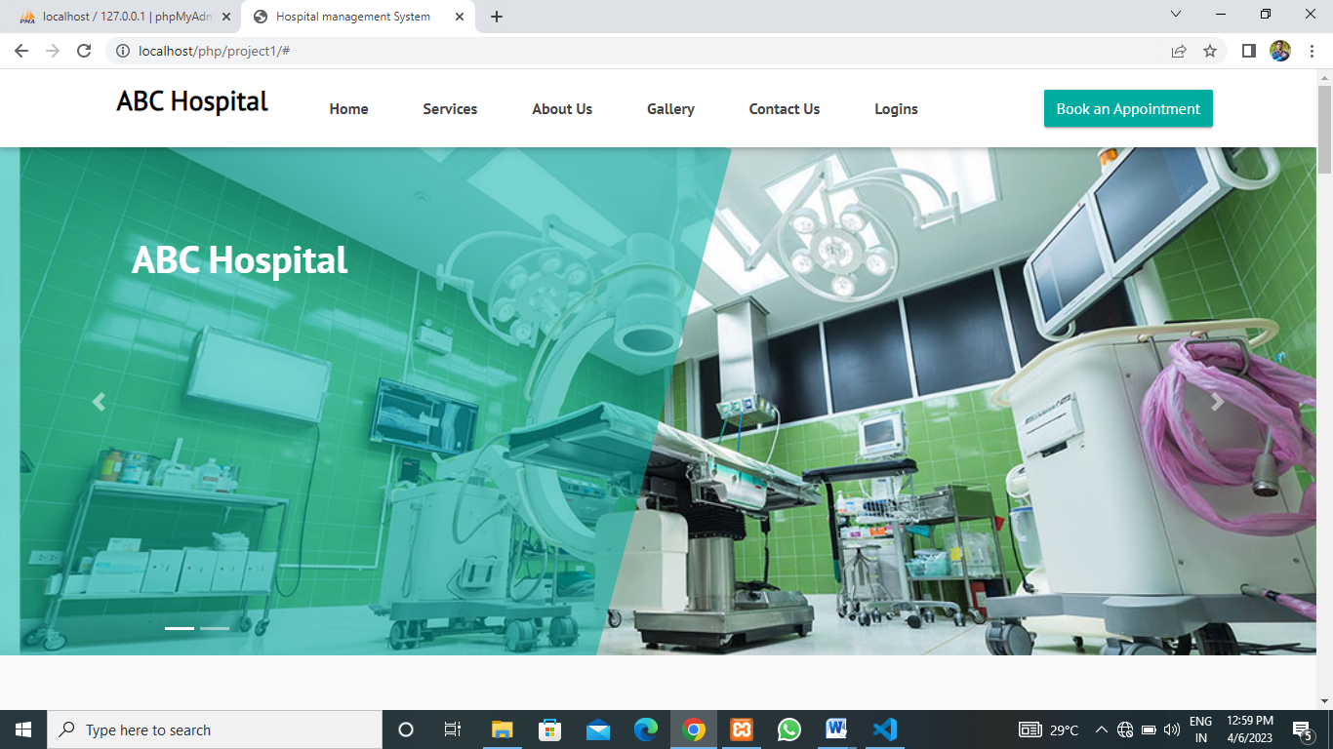
SCREEN SHOTS
HOME PAGE

Slide 20
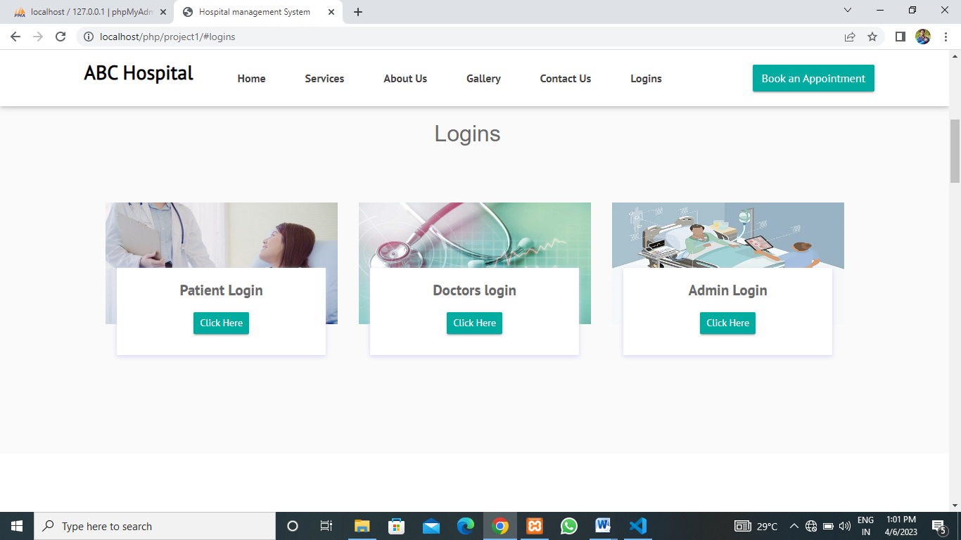
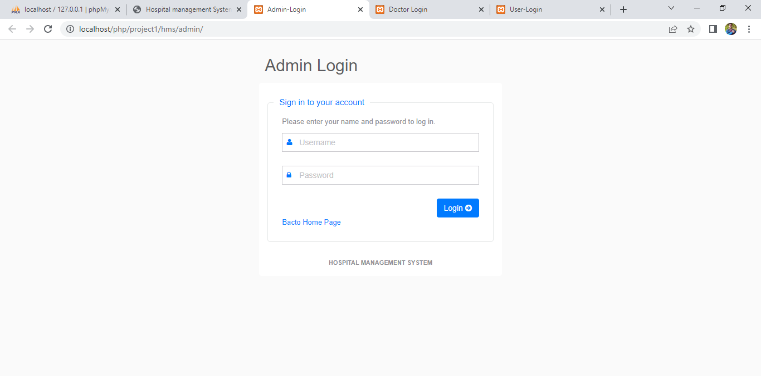
LOGIN PAGE
ADMIN LOGIN

Slide 21
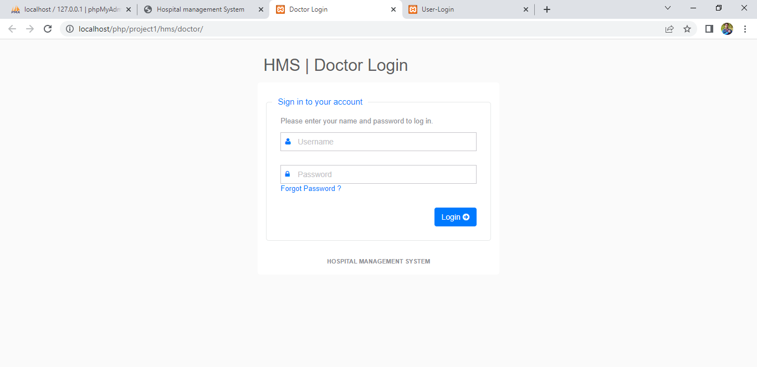
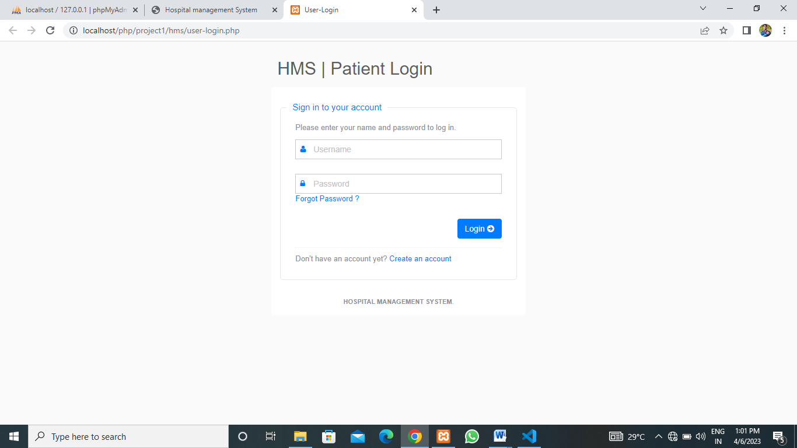
DOCTOR LOGIN
PATIENT LOGIN

Slide 22
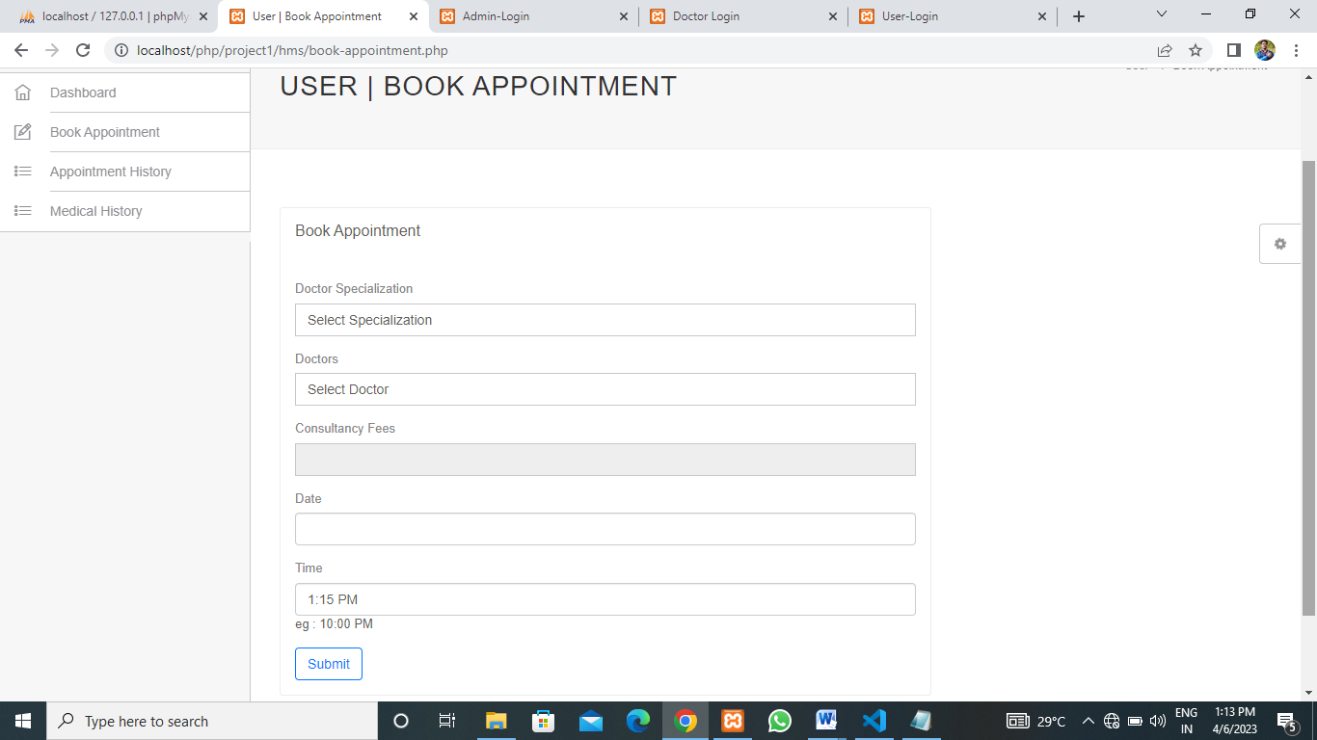
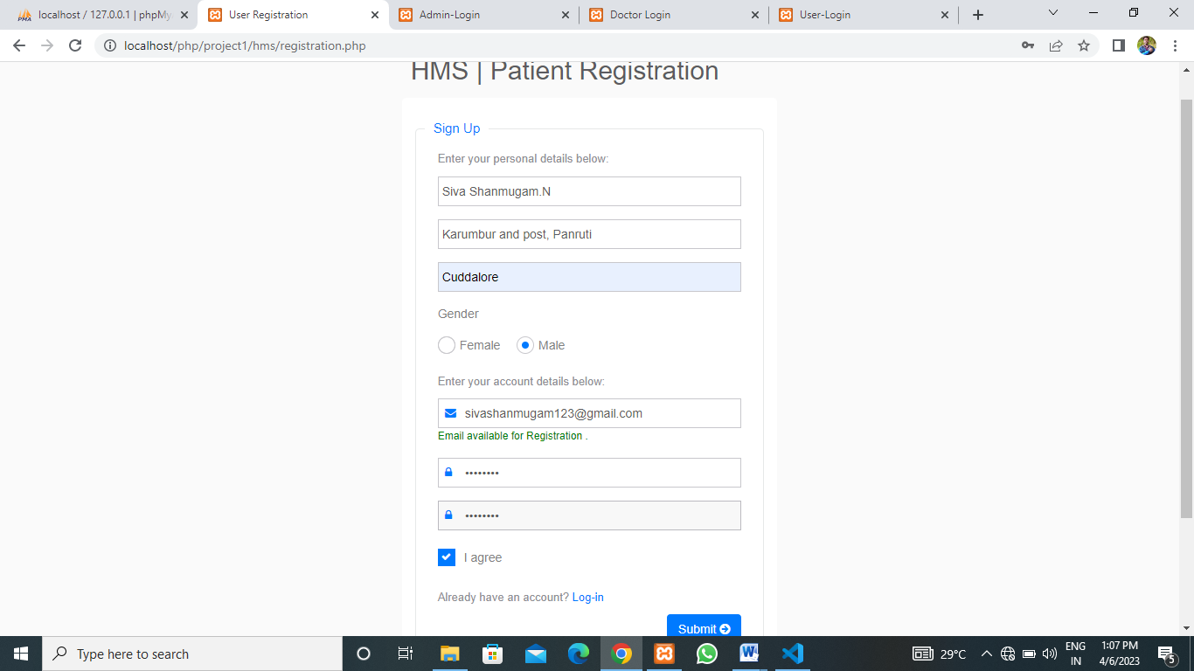
BOOK APPOINTMENT
PATIENT REGISTRATION

Slide 23
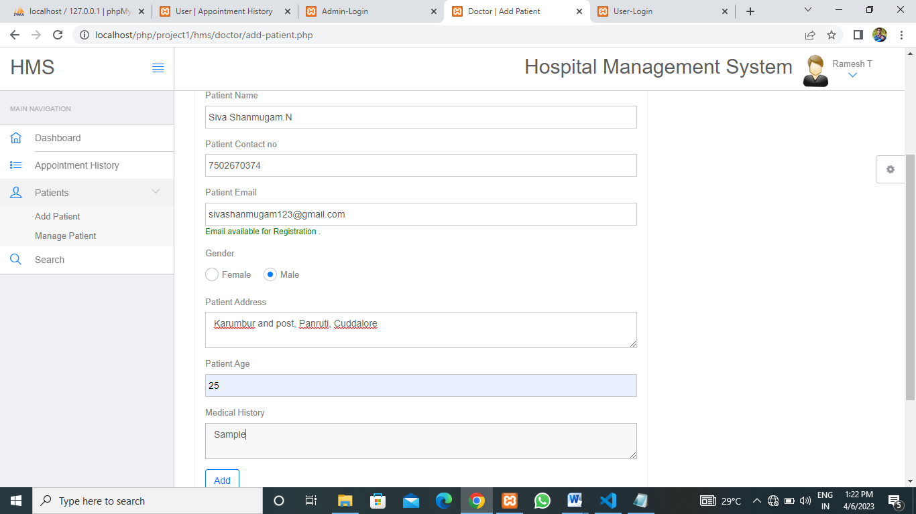
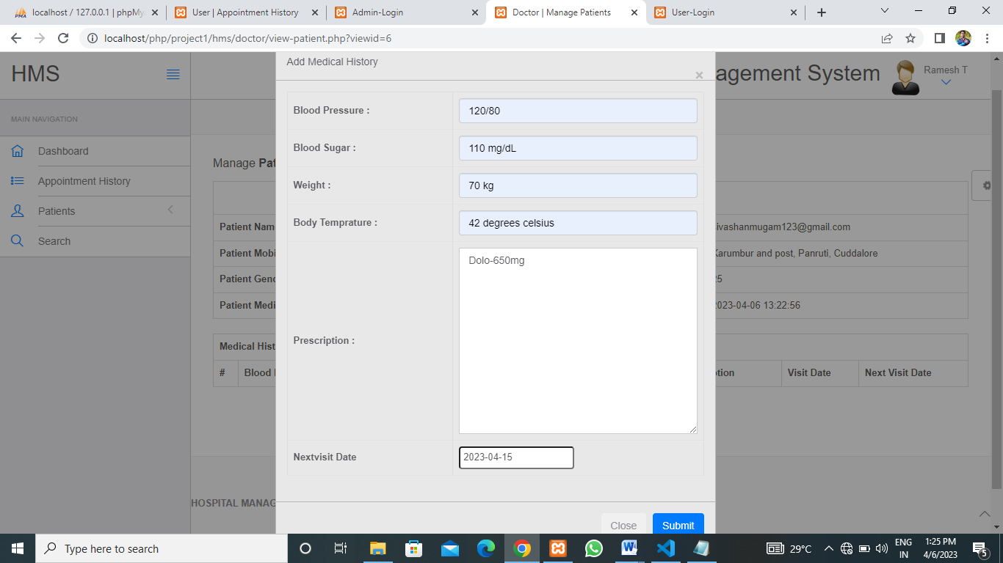
DOCTOR ADD-PATIENT
DOCTOR ADD-PATIENT MEDICAL HISTORY

Slide 24
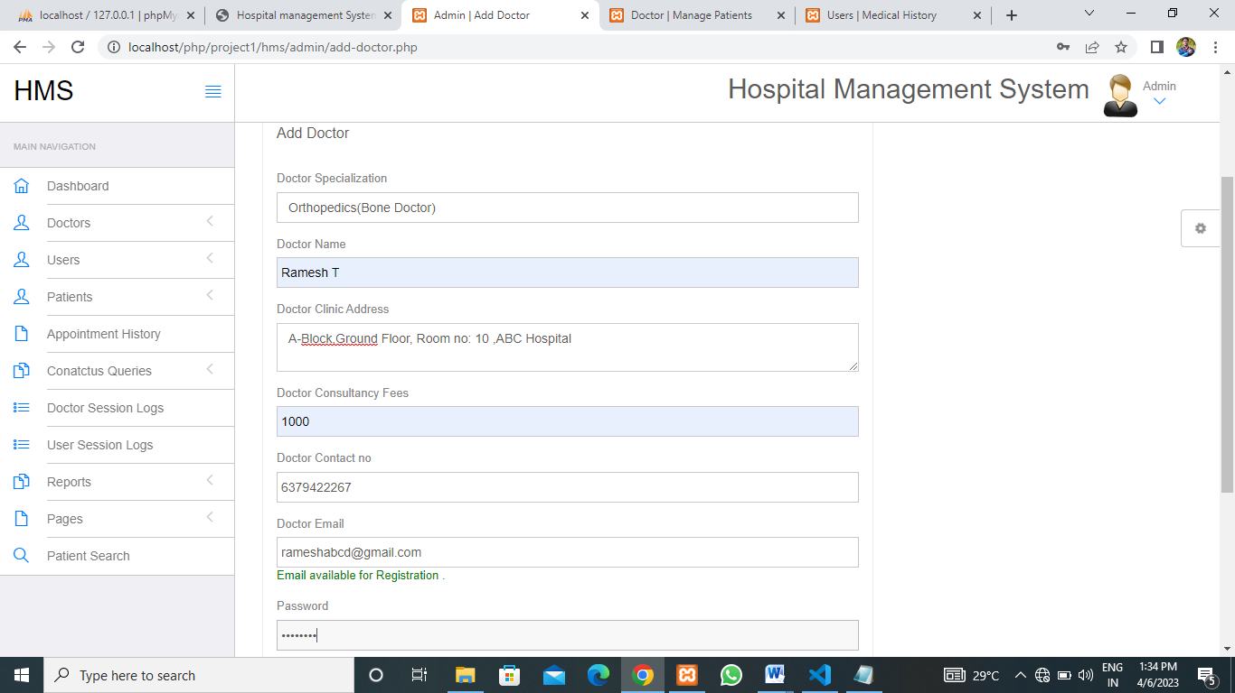
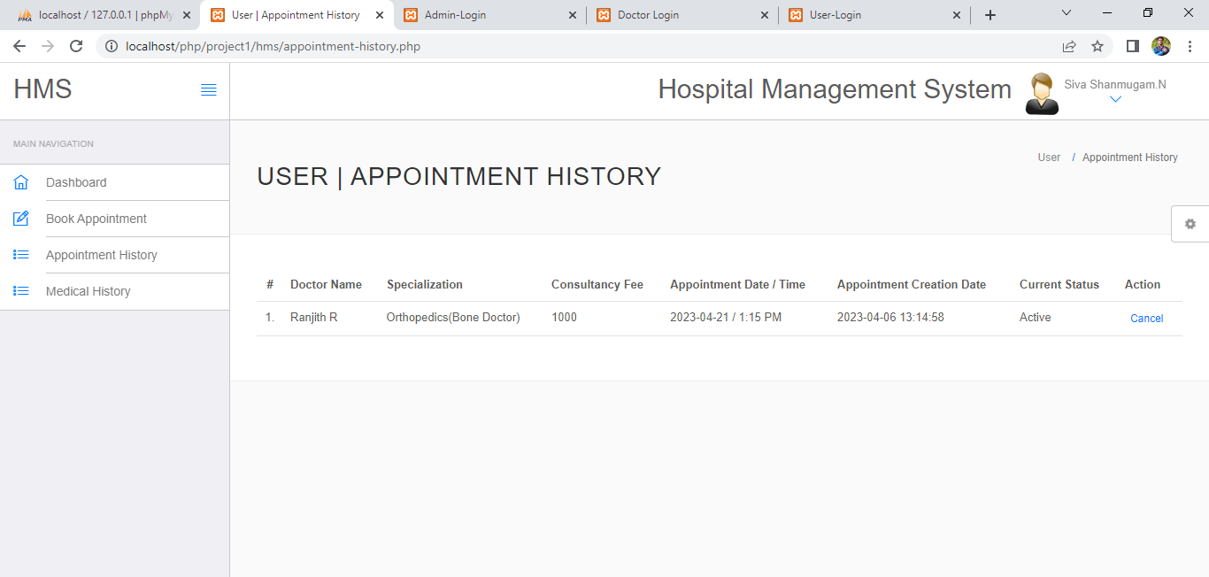
ADMIN ADD-DOCTOR
PATIENT APPOINTMENT-HISTORY

Slide 25
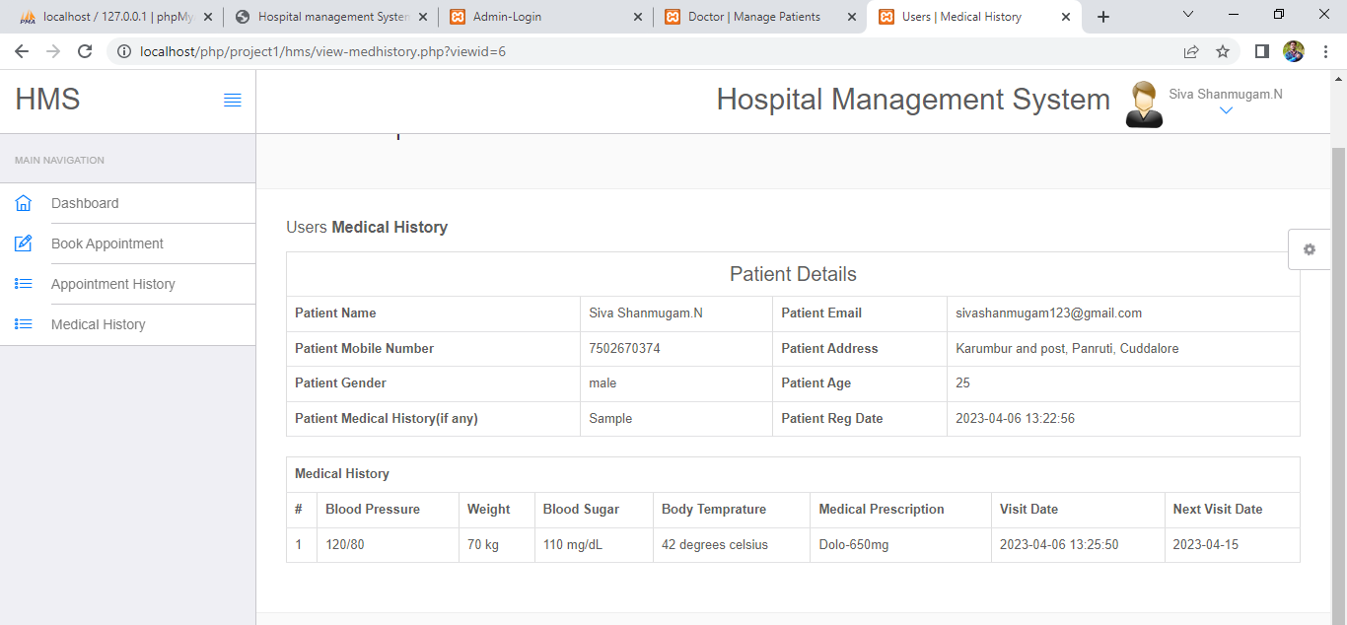
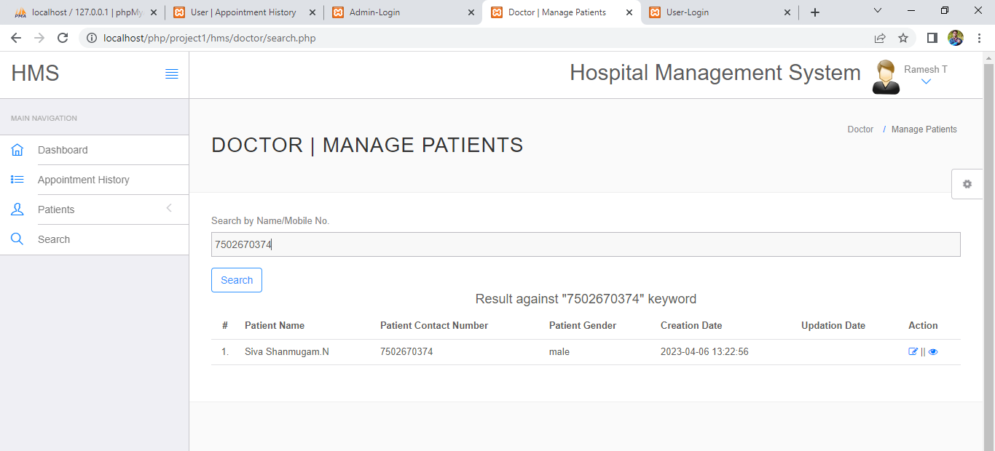
PATIENT MEDICAL-HISTORY
DOCTOR SEARCH-PATIENT

Slide 26
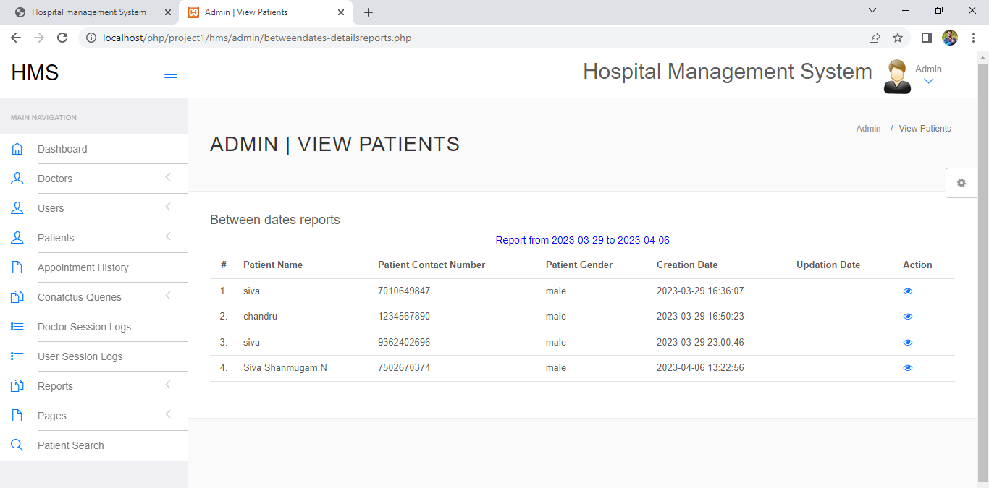
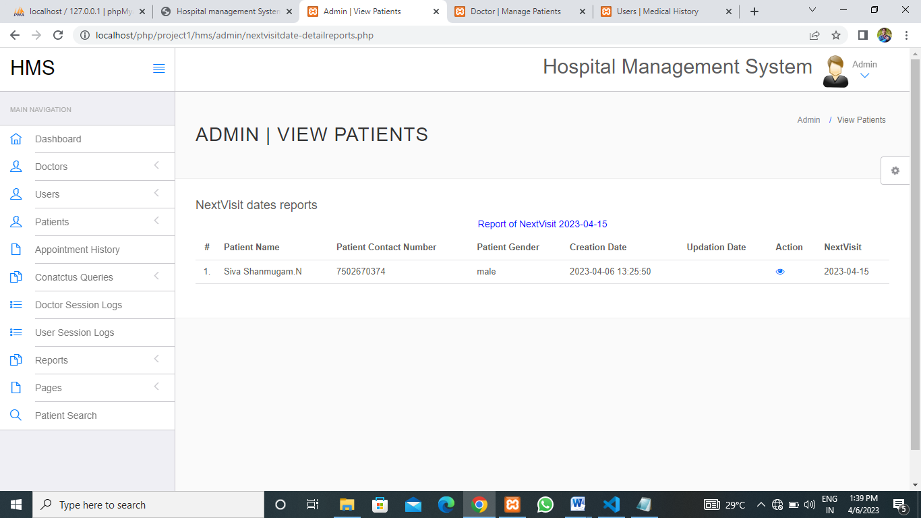
ADMIN VIEWS BETWEEN DATE REPORTS
ADMIN VIEWS NEXTVISIT OF PATIENT

Slide 27
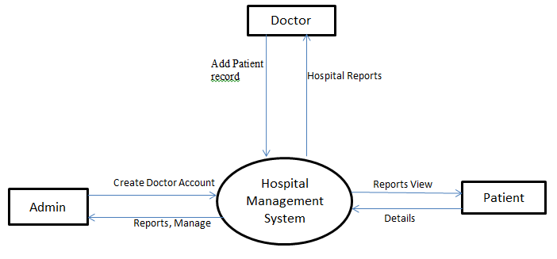
DATAFLOW DIAGRAM
DFD OF HOSPITAL MANAGEMENT SYATEM LEVEL-0
The Patient can interact with the Hospital System to make appointments, view medical records, and receive medical care. The Administrator can interact with the Hospital System to manage patient records, schedule appointments, and manage financial transactions. The medical staff can interact with the Hospital System to manage patient care, record medical data, and view patient records.

Slide 28
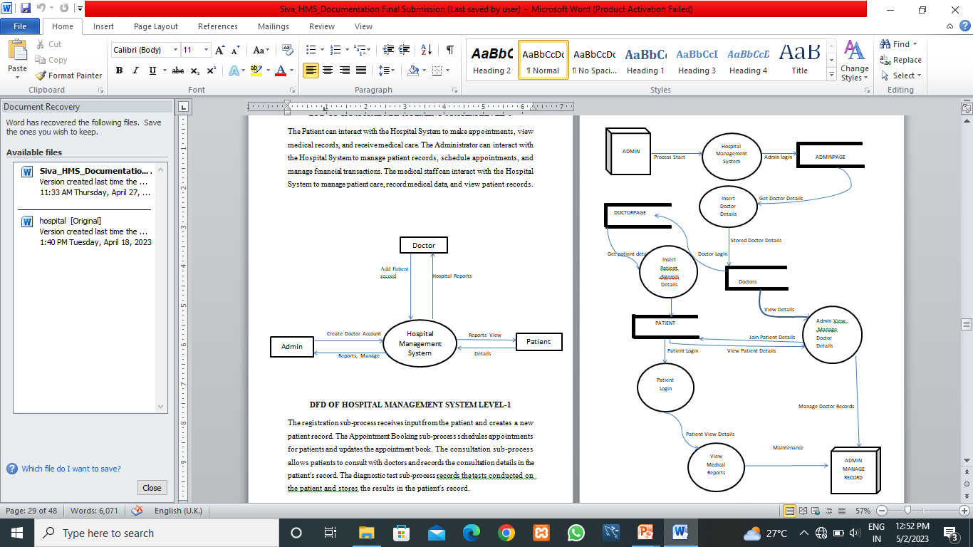
DFD OF HOSPITAL MANAGEMENT SYATEM LEVEL-1

Slide 29
CONCLUSION
Hospital management system is all about the modernizing a hospital through use of technology. Computer help in it and take over the manual system for quick and easy functioning. This hospital management system is a quite the reliable and is proven on many stages. All the basic requirements of the hospital are provided in the hospital in order to manage it perfectly and large amount of data can aslo be stored. It gives many facilities like searching for the detail of patient and creation of test reposts. So it’s a important system for morden days.
Since we are entering details of the patients electronically in the” Hospital Management System”, data will be secured. Using this application we can retrieve patient’s history with a single click. Thus processing information will be faster. It guarantees accurate maintenance of Patient details. It easily reduces the book keeping task and thus reduces the human effort and increases accuracy speed.

Slide 30
FUTURE ENHANCEMENT
This application avoids the manual work and the problems concern with it. It is an easy way to obtain the information regarding the various travel services that are present in our system.
Well I have worked hard in order to present an improved website better than the existing one’s regarding the information about the various activities. Still, we found out that the project can be done in a better way. Primarily, In this system patient login and then go to reception. By using this patient will send request for consulting the doctor. Reception will set the date for doctor appointments. After that doctor see his appointments and see the patients, surgeries also done.
The next enhancement is, we will develop online services. That mean, if patient have any problems he can send his problem to the doctor through internet from his home then doctor will send reply to him.

Slide 31
BIBLIOGRAPHY
REFERENCE BOOKS
[1] Luke Welling, Laura Thomson “PHP & MySQL Web Development”- 2008.
[2] Lynn Beighley and Michael Morrison“Head First PHP & MySQL”-2009.
[3] Janet Valade “PHP &MySQL for Dummies”-2004.
[4] Mike Murach “Murach’s PHP and MySQL”-2014.
[5] Jon Duckett “PHP & MySQL Server -Side Web Development”-2022.
REFERENCE WEBSITES
[1] http://www.w3schools.com
[2]www.tutorialspoint.php
[3]http://stackoverflow.com
[4] http://www.javatpoint.com
[5] http://www.mysql.com

Slide 32
THANK YOU

